Slide 1
Agile Change Management
Software Engineering
Neil Toporski

Slide 2
1 Change Management
Coping with Change
Agile is Transparent
Agile is Incremental and Iterative
Change Management Process

Slide 3
1.1 Coping with Change
Change is inevitable

Slide 4
Coping with Change
SYSTEMANTICS: John Gall
New systems generate new problems.
Peanut butter sandwiches fall peanut butter side down.
Complicated systems produce unexpected outcomes.
The real world is whatever is reported to the system.
If a system is working, leave it alone.
If a complex system designed from scratch never works and cannot be made to work – you have to start over, beginning with a working simple system.

Slide 5
Technological Disruption
Pattern Making
Covid: mRNA technology, Zoom, Supply Chain, Amazon
AI
Transportation: Self-driving vehicles
3.6 million truck drivers
ZOOX
Journalism. According to a recent BBC news report, by 2022 some 90% of all news content will be written by "robots.”
Health care (gene sequencing) , Agriculture, Manufacturing, Military
Computer coding (Codex OpenAI)
TV, iPhone (2007), Internet, email
Music: From Gramophone -> Vinyl -> Transistor Radios -> Audio Cassette -> 8-Track -> Walkman -> CD -> iPod -> Streaming

Slide 6
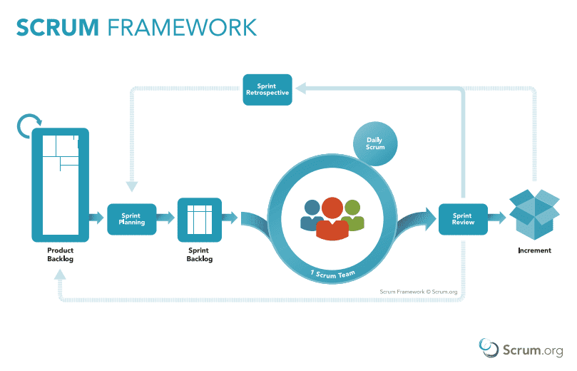





1.2 Agile is Transparent

Slide 7
1.2 Agile is Transparent
Project Vision Document (PID)
Prioritize Product Backlog
Meetings (Sprint Review, Retrospectives)
Release Planning Schedules
Burn Down/Up Charts
Scrum Board

Slide 8
1.3 Agile is Incremental and Iterative

Slide 9
1.4 Change Management Process
Create a request for change
Review and assess change request
Plan for the change
Create a change proposal
Implement changes
Review and test change performance
Close the process

